Slide 1

Information Security
Cryptography
PRESENTED BY :
APURVA KUMAR SINGH

Slide 2
Cryptography
Basics:
Cryptography is the science of secret, or hidden writing
It has two main Components:
  Encryption
    Practice of hiding messages so that they can not be read by anyone other than the intended recipient
  Authentication & Integrity
    Ensuring that users of data/resources are the persons they claim to be and that a message has not been surreptitiously altered

Slide 3


Encryption
Cipher
Cipher is a method for encrypting messages
Encryption algorithms are standardized & published
The key which is an input to the algorithm is secret
  Key is a string of numbers or characters
  If same key is used for encryption & decryption the algorithm is called symmetric
  If different keys are used for encryption & decryption the algorithm is called asymmetric
Plain Text
Encryption
Algorithm
Cipher Text
Decryption
Algorithm
Plain Text
Key A
Key B
Notes:
1. Must have done this as an assignment last year.

Slide 4
Encryption
Symmetric Algorithms
Algorithms in which the key for encryption and decryption are the same are Symmetric
  Example: Caesar Cipher
Types:
  Block Ciphers
    Encrypt data one block at a time (typically 64 bits, or 128 bits)
    Used for a single message
  Stream Ciphers
    Encrypt data one bit or one byte at a time
    Used if data is a constant stream of information

Slide 5
Symmetric Encryption
Key Strength
Strength of algorithm is determined by the size of the key
  The longer the key the more difficult it is to crack
Key length is expressed in bits
  Typical key sizes vary between 48 bits and 448 bits
Set of possible keys for a cipher is called key space
  For 40-bit key there are 2⁴⁰ possible keys
  For 128-bit key there are 2¹²⁸ possible keys
  Each additional bit added to the key length doubles the security
To crack the key the hacker has to use brute-force
  (i.e. try all the possible keys till a key that works is found)
  Super Computer can crack a 56-bit key in 24 hours
  It will take 2⁷² times longer to crack a 128-bit key
  (Longer than the age of the universe)
Notes:
1. Must have done this as an assignment last year.

Slide 6
Substitution Ciphers
Caesar Cipher
Caesar Cipher is a method in which each letter in the alphabet is rotated by three letters as shown
A B C D E F G H I J K L M N O P Q R S T U V W X Y Z
D E F G H I J K L M N O P Q R S T U V W X Y Z A B C
Let us try to encrypt the message
  Attack at Dawn
Assignment: Each student will exchange a secret message with his/her closest neighbor about some other person in the class and the neighbor will decipher it.

Slide 7
Substitution Ciphers
Caesar Cipher
Encryption
Plain Text
Message:
Attack at Dawn
Cipher:
Caesar Cipher
Algorithm
Cipher Text
Message:
Dwwdfn Dw Gdyq
Key (3)
Decryption
Cipher Text
Message:
Dwwdfn Dw Gdyq
Cipher:
Caesar Cipher
Algorithm
Plain Text
Message:
Attack at Dawn
Key (3)
How many different keys are possible?
Notes:
The key can be different -

Slide 8
Substitution Cipher
Monoalphabetic Cipher
Any letter can be substituted for any other letter
  Each letter has to have a unique substitute
There are 26! pairing of letters (~10²⁶)
Brute Force approach would be too time consuming
  Statistical Analysis would make it feasible to crack the key
A B C D E F G H I J K L M N O P Q R S T U V W X Y Z
M N B V C X Z A S D F G H J K L P O I U Y T R E W Q
Message:
Bob, I love you.
Alice
Cipher:
Monoalphabetic
Cipher
Encrypted
Message:
Nkn, s gktc wky.
mgsbc
Key
Notes:
Statistical Analysis
Knowing % of occurrences of different letters (e.g. e occurs 13% of time in the document and t occurs 19% of times)
Knowing commonly occurring two and three letter combinations (e.g. in, it, the, ion, ing, …)
If some knowledge about the content is available it is even easier to crack

Slide 9
Substitution Cipher
Polyalphabetic Caesar Cipher
Developed by Blaise de Vigenere
  Also called Vigenere cipher
Uses a sequence of monoalpabetic ciphers in tandem
  e.g. C₁, C₂, C₂, C₁, C₂
Example
Plain Text A B C D E F G H I J K L M N O P Q R S T U V W X Y Z
C1(k=6) F G H I J K L M N O P Q R S T U V W X Y Z A B C D E
C2(k=20) T U V W X Y Z A B C D E F G H I J K L M N O P Q R S
Message:
Bob, I love you.
Alice
Cipher:
Monoalphabetic
Cipher
Encrypted
Message:
Gnu, n etox dhz.
tenvj
Key
Notes:
Statistical Analysis
Knowing % of occurrences of different letters (e.g. e occurs 13% of time in the document and t occurs 19% of times)
Knowing commonly occurring two and three letter combinations (e.g. in, it, the, ion, ing, …)
If some knowledge about the content is available it is even easier to crack

Slide 10
Substitution Cipher
Using a key to shift alphabet
Obtain a key to for the algorithm and then shift the alphabets
  For instance if the key is word we will shift all the letters by four and remove the letters w, o, r, & d from the encryption
We have to ensure that the mapping is one-to-one
  no single letter in plain text can map to two different letters in cipher text
  no single letter in cipher text can map to two different letters in plain text
Plain Text A B C D E F G H I J K L M N O P Q R S T U V W X Y Z
C1(k=6) W O R D A B C E F G H I J K L M N P Q S T U V X Y Z
Message:
Bob, I love you.
Alice
Cipher:
Encrypted
Message:
??
WORD
Notes:
Statistical Analysis
Knowing % of occurrences of different letters (e.g. e occurs 13% of time in the document and t occurs 19% of times)
Knowing commonly occurring two and three letter combinations (e.g. in, it, the, ion, ing, …)
If some knowledge about the content is available it is even easier to crack

Slide 11
Transposition Cipher
Columnar Transposition
This involves rearrangement of characters on the plain text into columns
The following example shows how letters are transformed
  If the letters are not exact multiples of the transposition size there may be a few short letters in the last column which can be padded with an infrequent letter such as x or z
Plain Text
Cipher Text
T H I S I
S A M E S
S A G E T
O S H O W
H O W A C
O L U M N
A R T R A
N S P O S
I T I O N
W O R K S
T S S O H
O A N I W
H A A S O
L R S T O
I M G H W
U T P I R
S E E O A
M R O O K
I S T W C
N A S N S
Notes:
Statistical Analysis
Knowing % of occurrences of different letters (e.g. e occurs 13% of time in the document and t occurs 19% of times)
Knowing commonly occurring two and three letter combinations (e.g. in, it, the, ion, ing, …)
If some knowledge about the content is available it is even easier to crack

Slide 12
Ciphers
Shannon’s Characteristics of “Good” Ciphers
The amount of secrecy needed should determine the amount of labor appropriate for the encryption and decryption.
The set of keys and the enciphering algorithm should be free from complexity.
The implementation of the process should be as simple as possible.
Errors in ciphering should not propagate and cause corruption of further information in the message.
The size of the enciphered text should be no larger than the text of the original message.
Notes:
Statistical Analysis
Knowing % of occurrences of different letters (e.g. e occurs 13% of time in the document and t occurs 19% of times)
Knowing commonly occurring two and three letter combinations (e.g. in, it, the, ion, ing, …)
If some knowledge about the content is available it is even easier to crack

Slide 13
Encryption Systems
Properties of Trustworthy Systems
It is based on sound mathematics.
  Good cryptographic algorithms are are derived from solid principles.
It has been analyzed by competent experts and found to be sound.
  Since it is hard for the writer to envisage all possible attacks on the algorithm
It has stood the “test of time.”
  Over time people continue to review both mathematical foundations of an algorithm and the way it builds upon those foundations.
  The flaws in most algorithms are discovered soon after their release.
Notes:
Statistical Analysis
Knowing % of occurrences of different letters (e.g. e occurs 13% of time in the document and t occurs 19% of times)
Knowing commonly occurring two and three letter combinations (e.g. in, it, the, ion, ing, …)
If some knowledge about the content is available it is even easier to crack

Slide 14
Cryptanalysis
Techniques
Cryptanalysis is the process of breaking an encryption code
  Tedious and difficult process
Several techniques can be used to deduce the algorithm
  Attempt to recognize patterns in encrypted messages, to be able to break subsequent ones by applying a straightforward decryption algorithm
  Attempt to infer some meaning without even breaking the encryption, such as noticing an unusual frequency of communication or determining something by whether the communication was short or long
  Attempt to deduce the key, in order to break subsequent messages easily
  Attempt to find weaknesses in the implementation or environment of use of encryption
  Attempt to find general weaknesses in an encryption algorithm, without necessarily having intercepted any messages
Notes:
Statistical Analysis
Knowing % of occurrences of different letters (e.g. e occurs 13% of time in the document and t occurs 19% of times)
Knowing commonly occurring two and three letter combinations (e.g. in, it, the, ion, ing, …)
If some knowledge about the content is available it is even easier to crack

Slide 15
Data Encryption Standard (DES) Basics
Goal of DES is to completely scramble the data and key so that every bit of cipher text depends on every bit of data and ever bit of key
DES is a block Cipher Algorithm
  Encodes plaintext in 64 bit chunks
  One parity bit for each of the 8 bytes thus it reduces to 56 bits
It is the most used algorithm
  Standard approved by US National Bureau of Standards for Commercial and nonclassified US government use in 1993
Notes:
Statistical Analysis
Knowing % of occurrences of different letters (e.g. e occurs 13% of time in the document and t occurs 19% of times)
Knowing commonly occurring two and three letter combinations (e.g. in, it, the, ion, ing, …)
If some knowledge about the content is available it is even easier to crack

Slide 16
Data Encryption Standard (DES) Basics
64-bit input
56-bit key
48-bit k1
L1
R1
DES run in reverse to decrypt
Cracking DES
  1997: 140 days
  1999: 14 hours
TripleDES uses DES 3 times in tandem
  Output from 1 DES is input to next DES
F(L1, R1, K1)
48-bit k2
L2
R2
F(L2, R2, K2)
48-bit k3
L3
R3
F(L16, R16, K16)
48-bit k16
L17
R17
Notes:
DES consists of two permutations steps (the first and last steps of the algorithm)
Operation of each round is identical – taking output of the pervious round as input
During each round – the rightmost 32 bits of input are moved to left 32 bits of the output
The entire 64 bit input to the ith round and the 48-bit key for the ith round are taken as an input to a function
The function involves expansion of 4-bit chunks into 6-bit chunks , exclusive or-ing with the expanded 6-bit chunks of the 48-bit key Ki, a substitution operation and further exclusive OR-ing with the leftmost 32 bits of the input.
The resulting 32 bits of the input of the function is then used as the rightmost 32 bits of the round’s 64-bit output

Slide 17
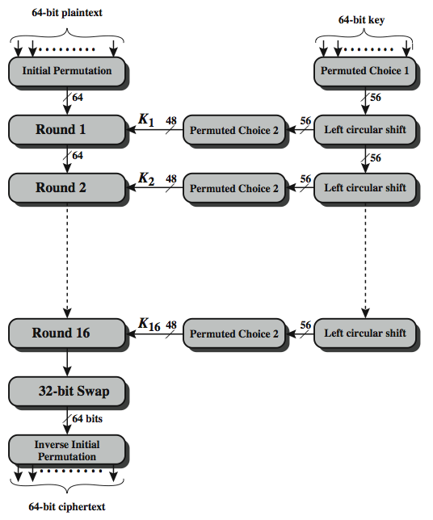
DES
Notes:
1. Must have done this as an assignment last year.

Slide 18
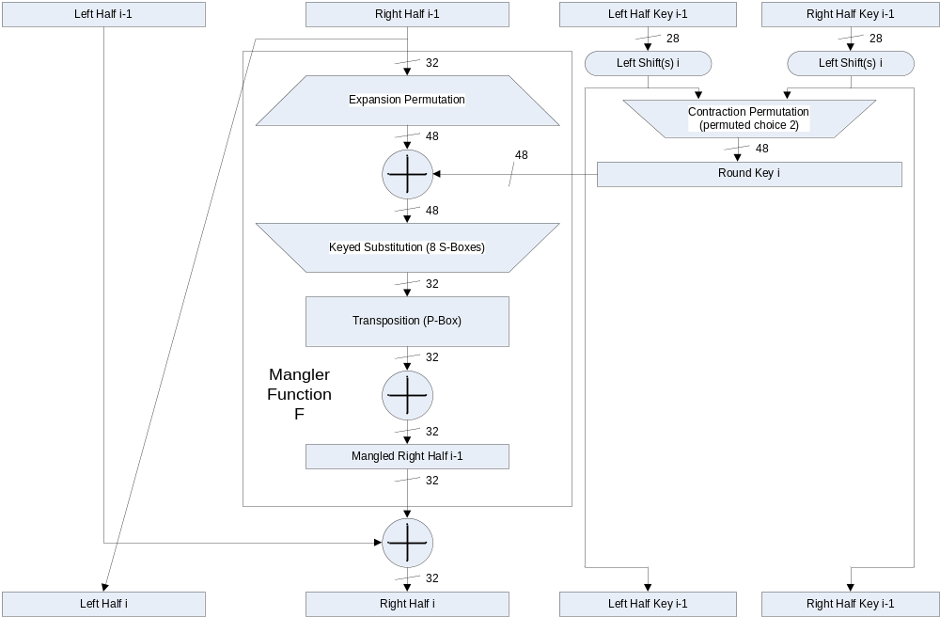
DES
Notes:
1. Must have done this as an assignment last year.

Slide 19

DES
Notes:
1. Must have done this as an assignment last year.

Slide 20
Encryption Algorithm
Summary
Algorithm | Type | Key Size | Features
DES | Block Cipher | 56 bits | Most Common, Not strong enough
TripleDES | Block Cipher | 168 bits (112 effective) | Modification of DES, Adequate Security
Blowfish | Block Cipher | Variable (Up to 448 bits) | Excellent Security
AES | Block Cipher | Variable (128, 192, or 256 bits) | Replacement for DES, Excellent Security
RC4 | Stream Cipher | Variable (40 or 128 bits) | Fast Stream Cipher, Used in most SSL implementations
Notes:
Statistical Analysis
Knowing % of occurrences of different letters (e.g. e occurs 13% of time in the document and t occurs 19% of times)
Knowing commonly occurring two and three letter combinations (e.g. in, it, the, ion, ing, …)
If some knowledge about the content is available it is even easier to crack

Slide 21
Symmetric Encryption
Limitations
Any exposure to the secret key compromises secrecy of ciphertext
A key needs to be delivered to the recipient of the coded message for it to be deciphered
  Potential for eavesdropping attack during transmission of key
Notes:
1. Must have done this as an assignment last year.

Slide 22
Asymmetric Encryption
Basics
Uses a pair of keys for encryption
  Public key for encryption
  Private key for decryption
Messages encoded using public key can only be decoded by the private key
  Secret transmission of key for decryption is not required
  Every entity can generate a key pair and release its public key
Plain Text
Cipher
Cipher Text
Cipher
Plain Text
Public Key
Private Key
Notes:
1. Must have done this as an assignment last year.

Slide 23
Asymmetric Encryption
Types
Two most popular algorithms are RSA & El Gamal
  RSA
    Developed by Ron Rivest, Adi Shamir, Len Adelman
    Both public and private key are interchangable
    Variable Key Size (512, 1024, or 2048 buts)
    Most popular public key algorithm
  El Gamal
    Developed by Taher ElGamal
    Variable key size (512 or 1024 bits)
    Less common than RSA, used in protocols like PGP
Notes:
1. Must have done this as an assignment last year.

Slide 24
Asymmetric Encryption
RSA
Choose two large prime numbers p & q
Compute n=pq and z=(p-1)(q-1)
Choose number e, less than n, which has no common factor (other than 1) with z i.e. gcd(e,z) = 1.
Find number d, such that ed – 1 is exactly divisible by z
i.e. ed mod z = 1.
Keys are generated using n, d, e
  Public key is (n,e)
  Private key is (n, d)
Encryption: c = m^{e} mod n
  m is plain text
  c is cipher text
Decryption: m = c^{d} mod n
Public key is shared and the private key is hidden
Notes:
1. Must have done this as an assignment last year.

Slide 25
Asymmetric Encryption
RSA
P=5 & q=7
n=5*7=35 and z=(4)*(6) = 24
e = 5
d = 29 , (29x5 –1) is exactly divisible by 24
Keys generated are
  Public key: (35,5)
  Private key is (35, 29)
Encrypt the word love using (c = m^{e} mod n)
  Assume that the alphabets are between 1 & 26
Plain Text | Numeric Representation | m^{e} | Cipher Text (c = m^{e} mod n)
l | 12 | 248832 | 17
o | 15 | 759375 | 15
v | 22 | 5153632 | 22
e | 5 | 3125 | 10
Notes:
1. Must have done this as an assignment last year.

Slide 26
Asymmetric Encryption
RSA
Decrypt the word love using (m = c^{d} mod n)
  n = 35, c=29
Cipher Text | c^{d} | (m = c^{d} mod n) | Plain Text
17 | 481968572106750915091411825223072000 | 12 | l
15 | 12783403948858939111232757568359400 | 15 | o
22 | 852643319086537701956194499721110000000 | 22 | v
10 | 100000000000000000000000000000 | 5 | e
Notes:
1. Must have done this as an assignment last year.

Slide 27
Asymmetric Encryption
Weaknesses
Efficiency is lower than Symmetric Algorithms
  A 1024-bit asymmetric key is equivalent to 128-bit symmetric key
Potential for man-in-the middle attack
It is problematic to get the key pair generated for the encryption
Notes:
1. Must have done this as an assignment last year.

Slide 28

Asymmetric Encryption
Man-in-the-middle Attack
Hacker could generate a key pair, give the public key away and tell everybody, that it belongs to somebody else. Now, everyone believing it will use this key for encryption, resulting in the hacker being able to read the messages. If he encrypts the messages again with the public key of the real recipient, he will not be recognized easily.
Bob
JOHN’s
Message
+ public key
Cipher
JOHN’s
Encrypted
Message
David’s
Public Key
Bob’s
Message
+ Public key
Cipher
David’s
Public Key
Bob’s
Encrypted
Message
JOHN
(Middle-man)
David
Bob’s
Public Key
Attacker
JOHN’s
Public Key
JOHN’s
Encrypted
Message
Cipher
JOHN’s
New Message
+ public key
JOHN’s
Encrypted
Message
Cipher
David’s
Message
+ public key
Notes:
1. Must have done this as an assignment last year.

Slide 29
Asymmetric Encryption
Session-Key Encryption
Used to improve efficiency
  Symmetric key is used for encrypting data
  Asymmetric key is used for encrypting the symmetric key
Plain Text
Cipher
(DES)
Cipher Text
Send to Recipient
Cipher
(RSA)
Encrypted
Key
Session Key
Recipient’s Public Key
Notes:
1. Must have done this as an assignment last year.

Slide 30
Asymmetric Encryption
Encryption Protocols
Pretty Good Privacy (PGP)
  Used to encrypt e-mail using session key encryption
  Combines RSA, TripleDES, and other algorithms
Secure/Multipurpose Internet Mail Extension (S/MIME)
  Newer algorithm for securing e-mail
  Backed by Microsoft, RSA, AOL
Secure Socket Layer(SSL) and Transport Layer Socket(TLS)
  Used for securing TCP/IP Traffic
  Mainly designed for web use
  Can be used for any kind of internet traffic
Notes:
1. Must have done this as an assignment last year.

Slide 31
Authentication
Basics
Authentication is the process of validating the identity of a user or the integrity of a piece of data.
There are three technologies that provide authentication
  Message Digests / Message Authentication Codes
  Digital Signatures
  Public Key Infrastructure
There are two types of user authentication:
  Identity presented by a remote or application participating in a session
  Sender’s identity is presented along with a message.
Notes:
Page 120-131, Secure Electronic Commerce

Slide 32
Authentication
Message Digests
A message digest is a fingerprint for a document
Purpose of the message digest is to provide proof that data has not altered
Process of generating a message digest from data is called hashing.
Hash functions are one way functions with following properties
  Infeasible to reverse the function.
  Infeasible to construct two messages which hash to same digest.
Commonly used hash algorithms are
  MD5 – 128 bit hashing algorithm by Ron Rivest of RSA
  SHA & SHA-1 – 162 bit hashing algorithm developed by NIST
Message
Message
Digest
Algorithm
Digest
Notes:
1. Must have done this as an assignment last year.

Slide 33
Message Authentication Codes
Basics
A message digest created with a key
Creates security by requiring a secret key to be possesses by both parties in order to retrieve the message
Message
Message
Digest
Algorithm
Digest
Secret Key
Notes:
1. Must have done this as an assignment last year.

Slide 34
Password Authentication
Basics
Password is secret character string only known to user and server
Message Digests commonly used for password authentication
Stored hash of the password is a lesser risk
  Hacker can not reverse the hash except by brute force attack
Problems with password based authentication
  Attacker learns password by social engineering
  Attacker cracks password by brute-force and/or guesswork
  Eavesdrops password if it is communicated unprotected over the network
  Replays an encrypted password back to the authentication server
Notes:
1. Must have done this as an assignment last year.

Slide 35
Authentication Protocols
Basics
Set of rules that governs the communication of data related to authentication between the server and the user
Techniques used to build a protocol are
  Transformed password
    Password transformed using one way function before transmission
    Prevents eavesdropping but not replay
  Challenge-response
    Server sends a random value (challenge) to the client along with the authentication request. This must be included in the response
    Protects against replay
  Time Stamp
    The authentication from the client to server must have time-stamp embedded
    Server checks if the time is reasonable
    Protects against replay
    Depends on synchronization of clocks on computers
  One-time password
    New password obtained by passing user-password through one-way function n times which keeps incrementing
    Protects against replay as well as eavesdropping
Notes:
1. Must have done this as an assignment last year.

Slide 36
Authentication Protocols
Kerberos
Kerberos is an authentication service that uses symmetric key encryption and a key distribution center.
Kerberos Authentication server contains symmetric keys of all users and also contains information on which user has access privilege to which services on the network
Notes:
1. Must have done this as an assignment last year.

Slide 37
Authentication
Personal Tokens
Personal Tokens are hardware devices that generate unique strings that are usually used in conjunction with passwords for authentication
Different types of tokens exist
  Storage Token: A secret value that is stored on a token and is available after the token has been unlocked using a PIN
  Synchronous one-time password generator: Generate a new password periodically (e.g. each minute) based on time and a secret code stored in the token
  Challenge-response: Token computes a number based on a challenge value sent by the server
  Digital Signature Token: Contains the digital signature private key and computes a computes a digital signature on a supplied data value
A variety of different physical forms of tokens exist
  e.g. hand-held devices, Smart Cards, PCMCIA cards, USB tokens
Notes:
1. Must have done this as an assignment last year.

Slide 38
Authentication
Biometrics
Uses certain biological characteristics for authentication
  Biometric reader measures physiological indicia and compares them to specified values
  It is not capable of securing information over the network
Different techniques exist
  Fingerprint Recognition
  Voice Recognition
  Handwriting Recognition
  Face Recognition
  Retinal Scan
  Hand Geometry Recognition
Notes:
1. Must have done this as an assignment last year.

Slide 39
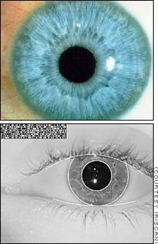
Authentication
Iris Recognition
The scanning process takes advantage of the natural patterns in people's irises, digitizing them for identification purposes
Facts
Probability of two irises producing exactly the same code: 1 in 10 to the 78th power
Independent variables (degrees of freedom) extracted: 266
IrisCode record size: 512 bytes
Operating systems compatibility: DOS and Windows (NT/95)
Average identification speed (database of 100,000 IrisCode records): one to two seconds
Notes:
1. Must have done this as an assignment last year.

Slide 40
Authentication
Digital Signatures
A digital signature is a data item which accompanies or is logically associated with a digitally encoded message.
It has two goals
  A guarantee of the source of the data
  Proof that the data has not been tampered with
Sender’s
Private Key
Sender’s
Public Key
Message
Sent to
Receiver
Digest
Algorithm
Digest
Algorithm
Message
Digest
Same?
Message
Digest
Signature
Algorithm
Digital
Signature
Sent to
Receiver
Signature
Algorithm
Message
Digest
Sender
Receiver
Notes:
To create a digital signature, the user simple creates a message digest of the document to be signed and then encrypts it with their private key.

Slide 41
Authentication
Digital Cerftificates
A digital certificate is a signed statement by a trusted party that another party’s public key belongs to them.
  This allows one certificate authority to be authorized by a different authority (root CA)
Top level certificate must be self signed
Any one can start a certificate authority
  Name recognition is key to some one recognizing a certificate authority
  Verisign is industry standard certificate authority
Identity
Information
Signature
Algorithm
Certificate
Sender’s
Public Key
Certificate Authority’s Private Key
Notes:
1. Must have done this as an assignment last year.

Slide 42
Authentication
Cerftificates Chaining
Chaining is the practice of signing a certificate with another private key that has a certificate for its public key
  Similar to the passport having the seal of the government
It is essentially a person’s public key & some identifying information signed by an authority’s private key verifying the person’s identity
The authorities public key can be used to decipher the certificate
The trusted party is called the certificate authority
Signature
Algorithm
Certificate
New Certificate
Certificate Authority’s Private Key
Notes:
A web browser has a digital certificate from verisign which is the root certification authority.

Slide 43
Cryptanalysis
Basics
Practice of analyzing and breaking cryptography
Resistance to crypt analysis is directly proportional to the key size
  With each extra byte strength of key doubles
Cracking Pseudo Random Number Generators
  A lot of the encryption algorithms use PRNGs to generate keys which can also be cracked leading to cracking of algorithms
Variety of methods for safe guarding keys (Key Management)
  Encryption & computer access protection
  Smart Cards
Notes:
A web browser has a digital certificate from verisign which is the root certification authority.

